Slide 1
ACONITUM NAPELLUS
Prepared By
Dr.SREEJA.S
H.o.D, Dept of Homoeopathic Pharmacy

Slide 2
Aconitum napellus
Synonym - monk's-hood, aconite, wolfsbane,
Is a species of flowering plant in the genus Aconitum of the family Ranunculaceae, native and endemic to western and central Europe.
It is a herbaceous perennial plant growing to 1 metre tall, with hairless stems and leaves. The leaves are rounded,
5–10 cm diameter, palmately divided into five to seven deeply lobed segments. The flowers are dark purple to bluish-purple, narrow oblong helmet-shaped, 1–2 cm tall.

Slide 3
Plants native to Asia and North America
ALKALOID
Aconitine is a potent neurotoxin that opens tetrodotoxin sensitive sodium channels. It increases influx of sodium through these channels and delays repolarization, thus increasing excitability and promoting ventricular dysrhythmias.

Slide 4
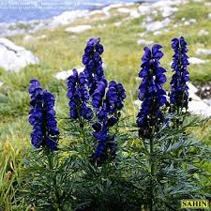
ACONITUM NAPELLUS

Slide 5
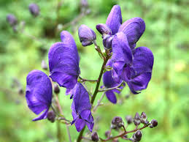
ACONITE FLOWER

Slide 6
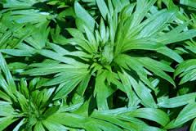
ACONITE LEAF

Slide 7
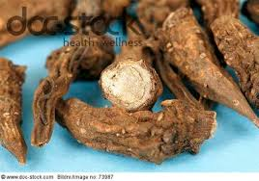
ACONITE ROOT

Slide 8
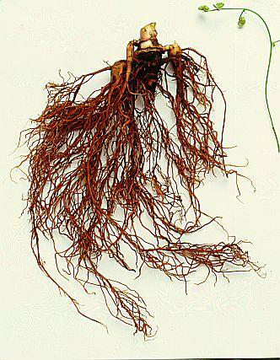
ACONITE ROOT

Slide 9
Common Name: Monkshood, aconite, blue rocket, cockoo's cap, friar's cap, garden monkshood, garden wolfs bane, helmet- flower, monkshood, poison aconite,
Family: Ranunculaceae.
Habitat: Grows in the Mountain Districts all over Europe.
Preparation: Q is prepared from the entire plant except the roots, its collected during the flowering season.
Proved by: Dr Samuel Hahnemann 1805.

Slide 10
History & Introduction
It is an extremely powerful and potentially toxic herb
In traditional Chinese medicine, this is considered an effective stimulant for the Spleen and Kidneys, and is a favorite treatment for Malaise, General Weakness, Poor Circulation, Cancer and Heart Disease.
Around the turn of the 19th Century, Finley Ellingword M.D. declared that , “Aconite has become the greatest of the agents used by the profession in control of Fever.”
Dr Ellingword also found that it could be extremely useful in the relief of acute pain.

Slide 11
The poison is mainly in the root, although the other plant parts are poisonous too. The scientific name Aconite is derived from the word AKONTION, meaning dart, as arrows or darts were frequently dipped into its poison.
The specific name “Napellus” signifies a little turnip, Aconite is one of the deadliest and most rapidly acting poisons,
It is one of Clarke’s A,B,C, Nurseries, others being Belladonna and Chamomilla. Aconite causes “turmoil in circulation”, Belladonna “turmoil in brain” and Chamomilla causes “turmoil in temperament”.

Slide 12
PHARMACOLOGICAL ACTION
Antipyretic
Analgesic
Sedative
Vasodilator
Emetic
Diaphoretic
Diuretic
Antirheumatic
Antidiarrhoeic

Slide 13
PATHOPHYSIOLOGICAL ACTION
Heart : Stimulates the inhibitory centre of vagus . Later vagus becomes exhausted and paralyzed .Reduces heart rate; lessens B.P.
Circulation : Vasomotor paralysis leading to arteriolar dilatation , Tachycardia, Palpitation, Cardiac arrest

Slide 14
Central Nervous System : At first stimulates and later paralyses the nerves of pain, touch and temperature, if applied to the skin, broken or unbroken, or to a mucous membrane . Initially numbness and tingling in extremities followed by long continued anesthetic action
Temperature : Initially depressed and Chilliness extends down the spine and sides
Later on general constant heat with high rise of temperature
Followed by diaphoresis with copious perspiration with lowering of temperature

Slide 15
Mucous Membrane Inflammation:
Respiratory tract - Influenza, cough and cold
G I Tract - Dysentery
Serous Membrane Adhesive Inflammation Pleurisy, Pericarditis, Peritonitis

Slide 16
Respiratory System : Depression of Respiratory Centre .Respiration becomes slower and deeper
Congestion and inflammation of lung ,Pneumonia
Stomach Congestion and inflammation of gastric mucosa , Vomiting and Pain
Neuralgia , Pain in abdomen

Slide 17
Tendons & Fibrous Tissues : Rheumatoid inflammation , Pain and swelling of joints
Muscular System : Increases the irritability of voluntary muscle , convulsions
1 g of Aconite root produce dangerous symptoms.
2 – 3 g is fatal
Death occurs from respiratory failure or vascullar fibrillation. Consciousness is retained till death

Slide 18
CONSTITUTION
Physical : Strong robust people with rigid fibers; dark hair and eyes; young person especially girls of a full, plethoric habit who lead a sedentary life; rosy; chubby and plethoric babies; persons who are easily affected by atmospheric changes
Mental : Nervous, Fearful and Sanguine temperament
Thermal : Aconite seems to be a warm blooded patient
Diathesis : Scrofulous diathesis
Miasm : Psora is in the background

Slide 19
CAUSATION
1. Exposure to dry cold air, dry north or west winds.
2. Exposure to draughts of cold air while in perspiration
3.Bad effects of checked perspiration
4.From fear or excitement
5.Effects of fright either immediate or remote
6. Heat of sun
7. From injury or surgical operations

Slide 20
SIGNS & SYMPTOMS
1. Sudden and Violent: Acute, sudden and violent invasion calls for it.
All the acute cases occur suddenly and with great intensity e.g. influenza, cholera, fevers, acute inflammations and even sudden blindness.
2. Especially suited to congestive stage of inflammation before localization takes place.
3. Tension: Dr Hughes, “Tension” Emotional and mental tension Muscular tension, as in tetanus, convulsions; tension of involuntary muscles, as in cardiac spasm; tension of the semi-involuntary muscle of respiration as in asthma.

Slide 21
4. Fear: Fear is etched upon one’s countenance: Fear of dark, Fear of crowds, Fear to cross the streets, Fear of Death during pregnancy.
Fear of Death: Predicts the day and hour of his death.

Slide 22
5. Fright: Threatened abortion from fright or anger, amenorrhea after fright; vertigo after fright.
6. Mental anxiety, worry and fear accompany the most trivial ailment.
7. Restlessness: “Anxious restlessness”, i.e. restlessness accompanied by anxiety; does everything in great haste must change position often; during fever intense nervous restlessness with tossing about in agony

Slide 23
8. Hypersensitivity: To pain, touch, sound, smell
Pain : Pains are intolerable, drives him crazy, patient screams with pain; pains are always attended with restlessness and numbness; worse at night

Slide 24
9. Burning: Burning runs all through the remedy. Burning heat in fever, burning in head, as if there were burning water in brain; burning in spine; burning during micturition with scanty urination; burning thirst.
10. Numbness and tingling: Pains are accompanied by numbness and tingling; paralysis accompanied by coldness, numbness and tingling, neuralgia especially of left side with numbness, tingling and restlessness ss

Slide 25
11. Unquenchable burning thirst for large quantities of cold water. (Ars: Thirst for small quantities of cold water at short intervals; Bry: Thirst for large quantities of cold water at long intervals)
12. Skin dry and hot: during fever face red , or pale and red alternately; sweat scanty, only on uncovered parts (covered parts – Belladonna)
13. Hemorrhage: Profuse; bright red, from nose, lungs, stomach; bleeding piles with heat and sharp stitches, sudden severe pain in stomach with gagging, retching and vomiting of blood.

Slide 26
14. Modalities:
Aggravation: evening, night, warm room, lying on affected side; from music, tobacco smoke, when rising from bed, dry cold air.
Amelioration: In the open air. Perspiration

